Slide 1
High performance Coding with .NET Core and C#
Gergely Kalapos
Elastic
Web: www.kalapos.net
Twitter: @gregkalapos

Slide 2
Gergely Kalapos Web: http://kalapos.net Twitter: @gregkalapos
Works on observability and performance monitoring tools at Elastic
Loves OpenSource, works in a distributed Team
Born in Hungary, lives in Austria

Slide 3
GitHub repo with slides and sample code
tiny.cc/gwm46y

Slide 4
Agenda
LINQ Sample - .NET Core vs. Full Framework
BenchmarkDotNet
Why is Performance important?
ArrayPool
C# 7 ref return
Span<T>
SIMD and Vectorization

Slide 5
Terminology
C# Code
Full Framework
Desktop CLR
.NET Core
CoreCLR
IL Code
Compile time
C# Compiler
IL Code
JIT Compiler
Run time
Machine Code

Slide 6
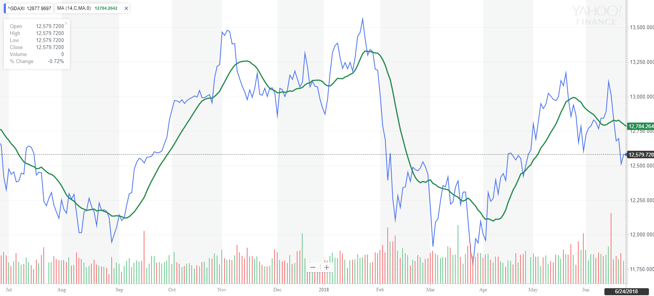
Full Framework vs. .NET Core – LINQ - Moving average calculation
public static List<Quote> CalculateSMALinq(List<HistoricalValue> Price, int SMALength)
{
List<Quote> retVal = new List<Quote>();
for (int i = 0; i < Price.Count() - SMALength + 1; i++)
{
var firstSmaLengthItems = Price.Skip(i).Take(SMALength);
var firstAvg = firstSmaLengthItems.Average(n => n.Close);
retVal.Add(new Quote { Date = firstSmaLengthItems.Last().Date,
Value = firstAvg });
}
return retVal;
}
*There are better SMA algorithms!

Slide 7
Full Framework vs .NET Core - LINQ
Benchmarking - summary:
MSFT Stock
14-days Simple Moving Average
Von 1986
~80.000 data points
https://github.com/gregkalapos/ADC19Samples/tree/master/Sample1_Linq_FullFramework_Vs_DotNetCore

Slide 8
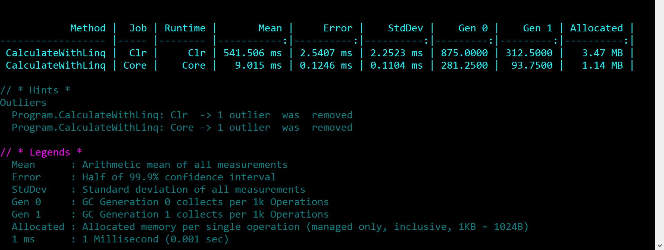
Full Framework vs .NET Core - LINQ
~60x Performance improvement thanks to Community Contribution (Jon Hanna)
https://github.com/dotnet/corefx/commit/a087c2d97d818762c1b4dd2c6305a2d9e836631c#diff-5c3753c526c75a2790d71c348c0c364aR246
https://github.com/dotnet/corefx/blob/master/src/System.Linq/src/System/Linq/Skip.cs#L35

Slide 9
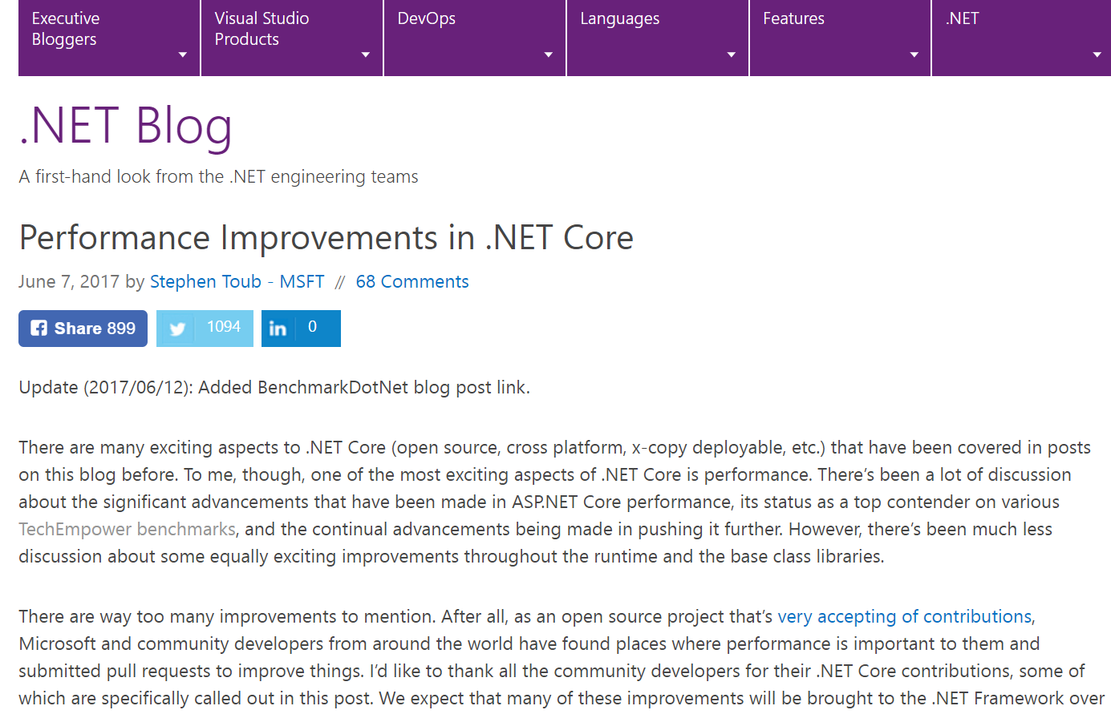
.NET Blog - Performance Improvements in .NET Core
Pos with perf. improvements with benchmarks
https://devblogs.microsoft.com/dotnet/performance-improvements-in-net-core-3-0/
https://blogs.msdn.microsoft.com/dotnet/2017/06/07/performance-improvements-in-net-core/

Slide 10
BenchmarkDotNet
15:45-16:51: "Einstieg in Performanceoptimierung mit BenchmarkDotNet”
Add NuGet package: “BenchmarkDotNet"

Slide 11
BenchmarkDotNet
namespace BenchmarkSample
{
[MemoryDiagnoser]
public class Program
{
static void Main(string[] args)
{
var summary = BenchmarkRunner.Run<Program>();
}
[Benchmark]
public static void BenchmarkMethod()
{
//work to measure
}
}

Slide 13
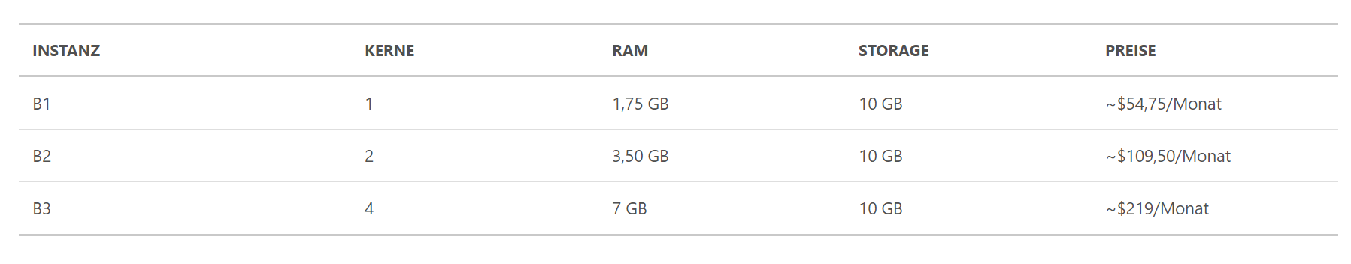
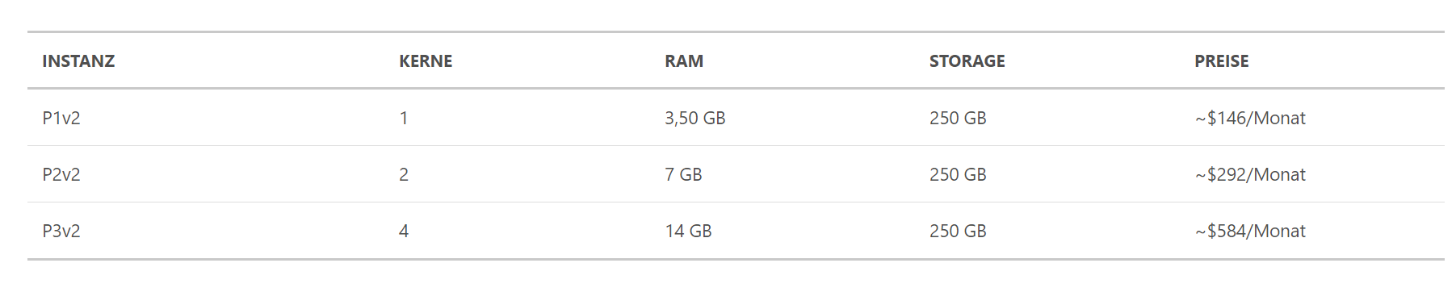
Why is Performance important? – Cloud
Azure App Service costs
Basic:
In case an application runs on a:
single B1 instance: 54,75$/Monat
Single P3v2 instance: 584$/Monat
50 P3v2 instances : 29200$/Monat
Premium:

Slide 14

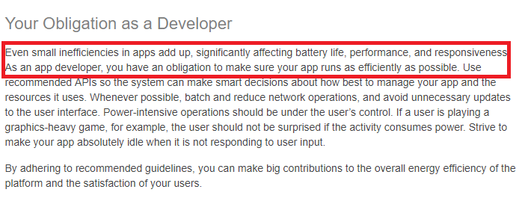
Why is Performance important? – Mobile

Slide 15
Web applications
SEO
Conversion-rate
Slow Website -> Unhappy users
Docker

Slide 16
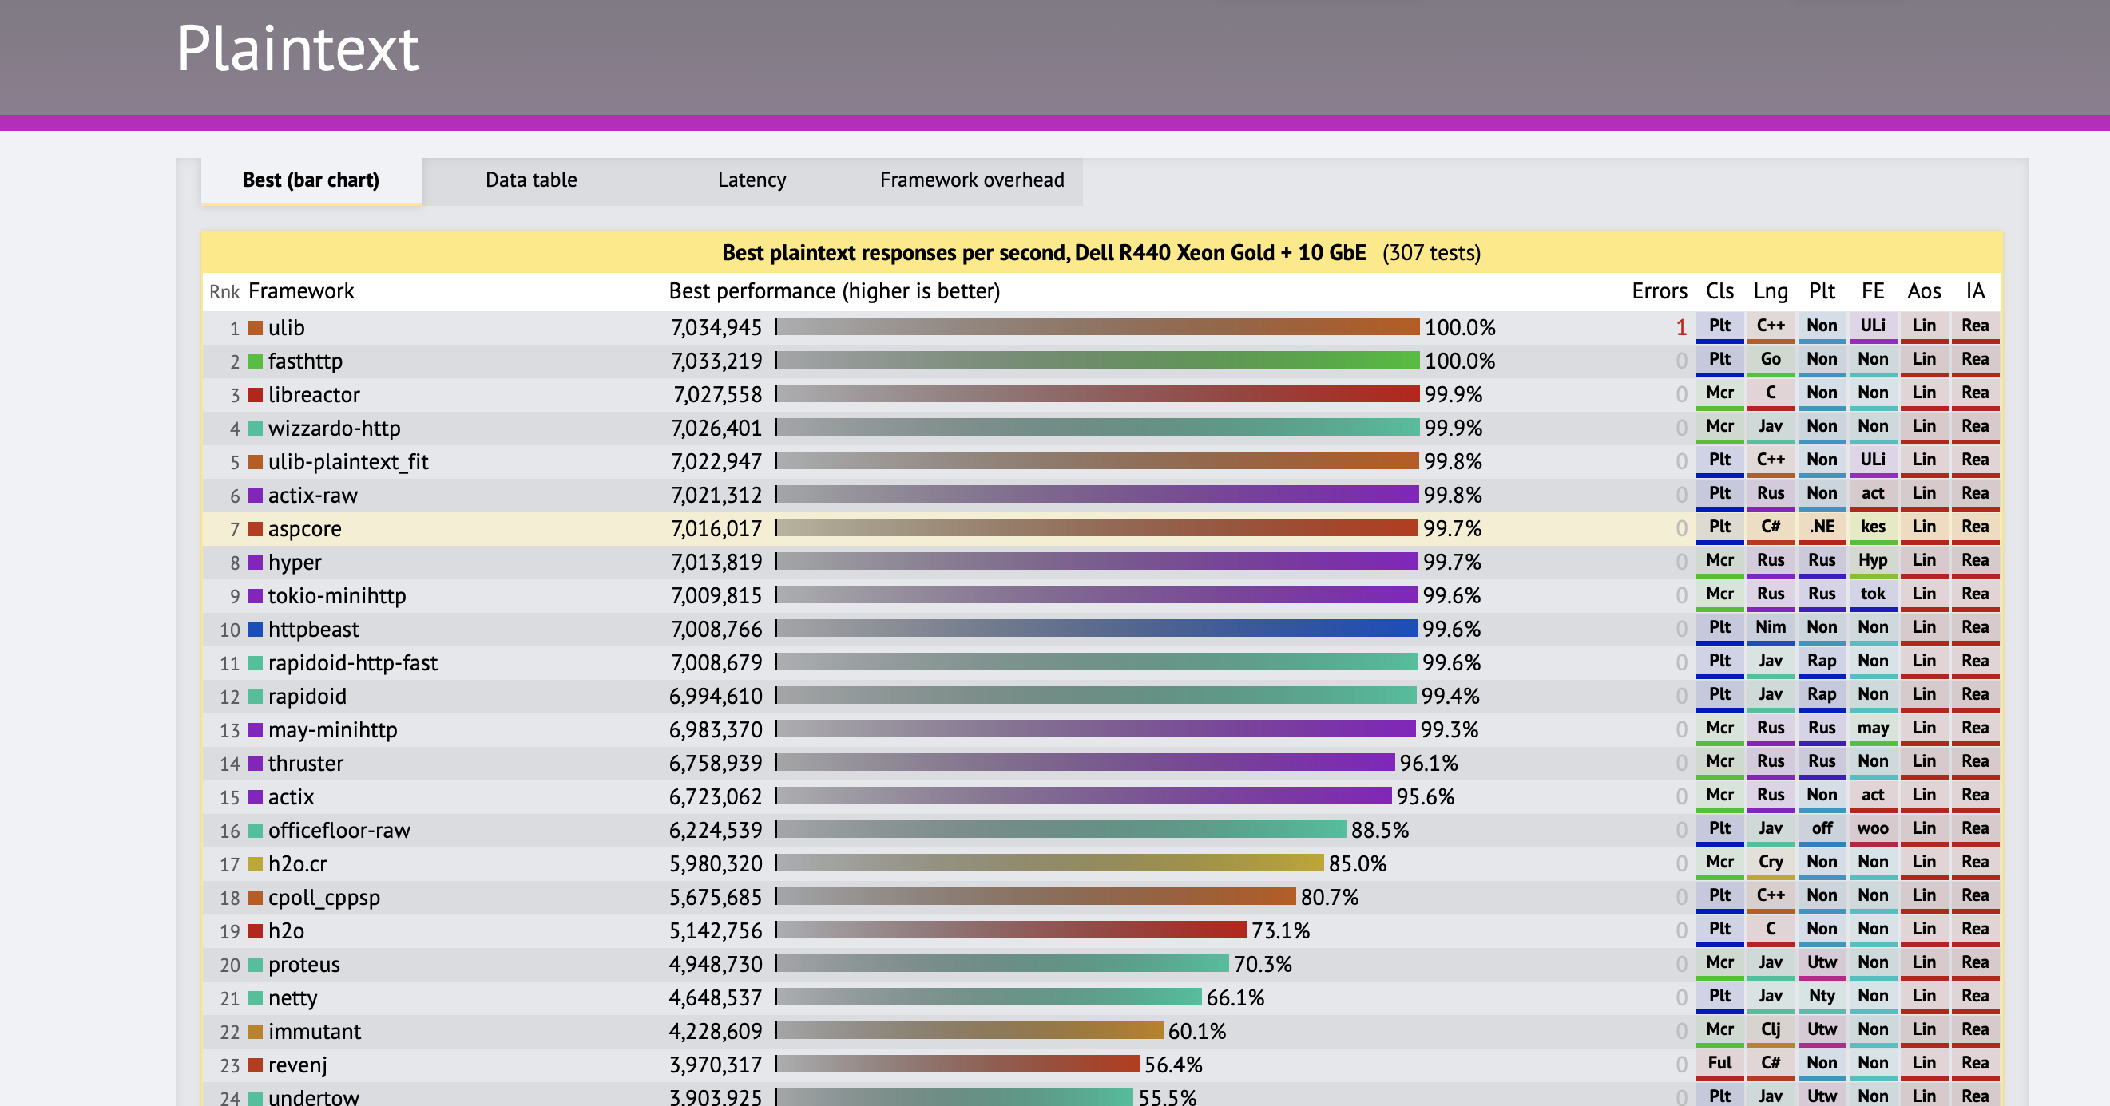
Techempower Benchmark

Slide 17
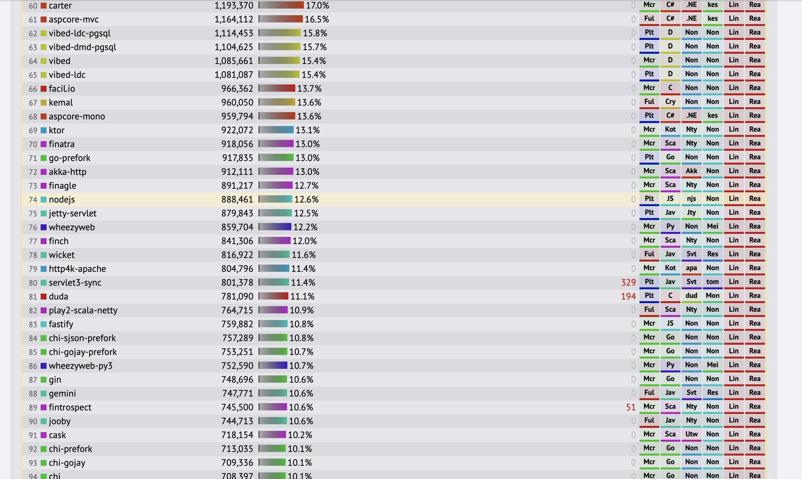
Techempower Benchmark

Slide 18

Techempower Benchmark

Slide 19
ArrayPool

Slide 20
Managed Heap - GC Segments
var obj = new Object();
var array = new int[100_000];
Gen0
Gen1
Gen2
Large Object Heap (LOH)
obj
array
Objects bigger than 85.000 Bytes
Small Object Heap (SOH)
Large Object Heap Collection = Full GC (Gen0+Gen1+Gen2+LOH)

Slide 21
Arrays and GC
Method with array allocation
public void MethodCalledOften()
{
var myArray = new int[15];
//use myArray...
}
myArray is allocation on the heap -> more work for the GC
In each call memory is allocation-> GC cleans up -> and in the next round memory is allocated again

Slide 22
Arrays and GC
Method with a bigger array
public void MethodCalledOften()
{
var myArray = new int[256*1024];
//use myArray...
}
myArray is allocated on the Large Object Heap -> even more work for the GC

Slide 23
Solution: ArrayPool<T>
Holds a number of objects ready to use
.NET Standard 2.1
NuGet package: System.Buffers - can be used already with .NET Core 1.0, Included in .NET Core 2.1 SDK - Microsoft.NETCore.App
ArrayPool<T>.Shared.Rent(int length): gives you an array
ArrayPool<T>.Shared.Return(T[] array): you give the array back to the pool
https://github.com/dotnet/corefx/blob/master/src/Common/src/CoreLib/System/Buffers/ArrayPool.cs

Slide 24
ArrayPool
Instead of allocation an array each time, use ArrayPool:
public void MethodCalledOften()
{
var arr = ArrayPool<int>.Shared.Rent(256 * 1024);
Console.WriteLine(arr[0].ToString());
//use arr.
ArrayPool<int>.Shared.Return(arr);
}

Slide 25
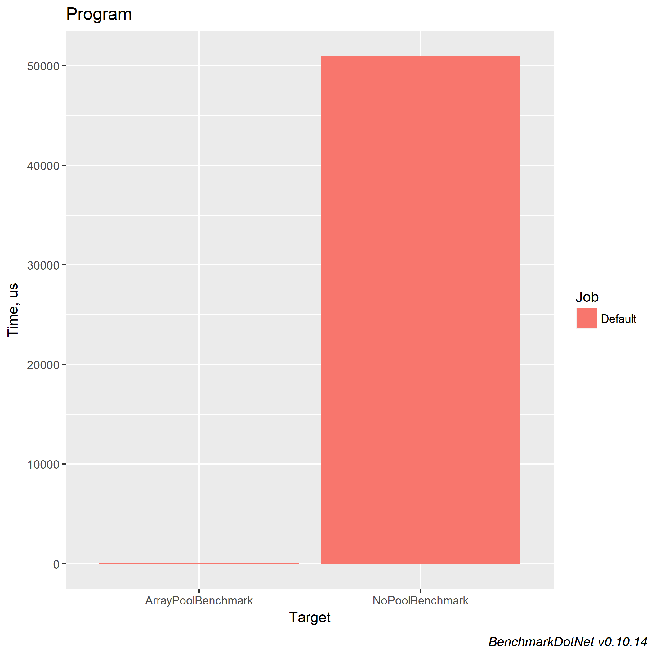
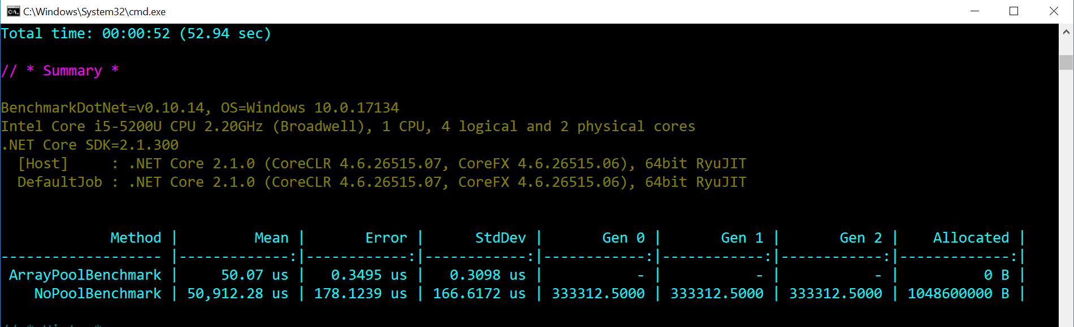
Benchmark Ergebnis
1000 iterations: ArrayPool.Shared.Rent() vs. new Array[]
https://github.com/gregkalapos/DWX2018_SampleCode/tree/master/ArrayPoolSample

Slide 26
ArrayPool – A few more things
ArrayPool<T>.Shared is the „Shared Pool“
Max array size in Shared Pool: 2²⁰ (1024*1024)
Calling Shared.Rent(n) with n > 2²⁰: new array will be allocated -> no pooling
ArrayPool<T>.Create(maxArrayLength, maxArraysPerBucket) creates a new pool. With that you can create pools with arrays bigger than 2²⁰

Slide 27
ArrayPool – Creating a custom pool
Pooling Arrays with size > 2²⁰ (1024 * 1024)
public ArrayPool<int> MyPool =
ArrayPool<int>.Create(1024*1024*3, 10);
public void MethodWithCustomPool()
{
var arr = MyPool.Rent(1024*1024*2);
//use arr...
MyPool.Return(arr);
}

Slide 28
ArrayPool – Summary
Very simple API -> goal: avoid GC (especially Gen2 GC)
Shared Property returns there Shared-Pool (max. 2²⁰)
The Create method created a new Pool
Where is ArrayPool used? E.g.: Kestrel, ASP.NET Core

Slide 29
Ref return, ref local

Slide 30
Reference types – object header
Advantage: Polymorphism, Inheritance, lock(){}
Disadvantage: higher memory usage, can be only allocated on the heap
class Point
{
int x, y;
}
Per Object Overhead
Sync Block Index
Method Table Pointer
Instance var. 1
Instance var. 2
…

Slide 31
Value Types on .NET (and .NET Core)
Contains the value directly
E.g.: Numerical Typen, Bool, Char, Date, Structs, Enums
With “=“ is the contained value copied
With “==“ are the contained valued compared
Struct Point:
Int: X
Int: Y
Point p = new Point();

Slide 32
Benchmark: class vs. struct
public class Point_Class
{
public int x;
public int y;
}
public struct Point_Struct
{
public int x;
public int y;
}
vs.

Slide 33
Benchmark: class vs. struct
static List<Point_Class> ClassList
= new List<Point_Class>();
[Benchmark]
public static void ManyClasses()
{
for (int i = 0; i < 1_000_000; i++)
{
if(ClassList[i].x == -1)
{
Debug.WriteLine("-1");
}
}
}
static List<Point_Struct> StructList
= new List<Point_Struct>();
[Benchmark]
public static void ManyStructs()
{
for (int i = 0; i < 1_000_000; i++)
{
if (StructList[i].x == -1)
{
Debug.WriteLine("-1");
}
}
}

Slide 34
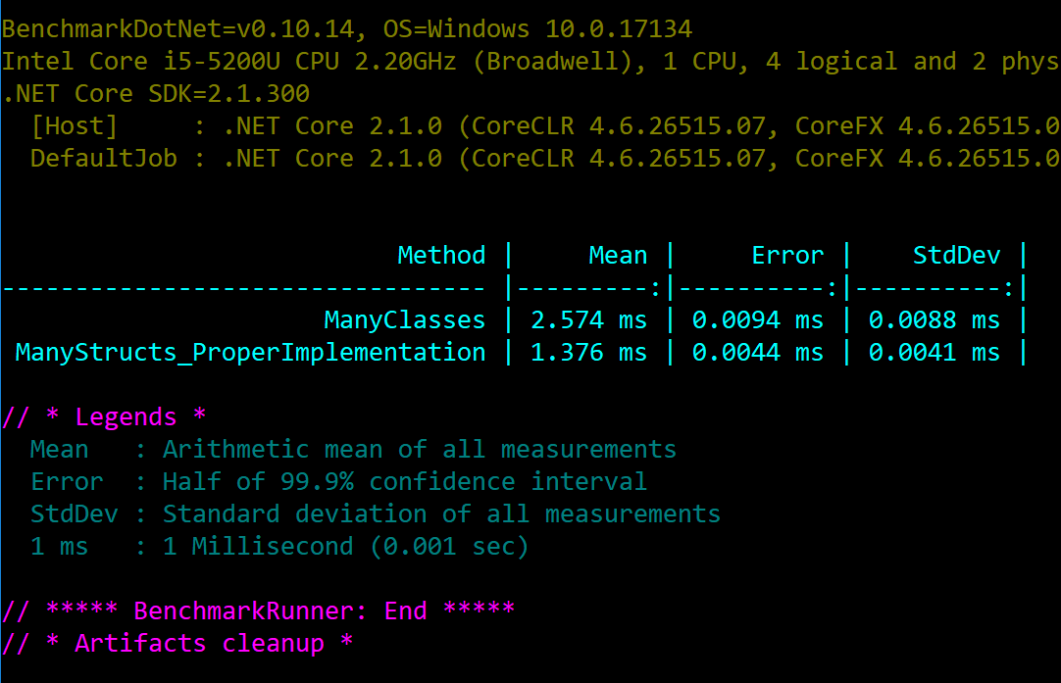
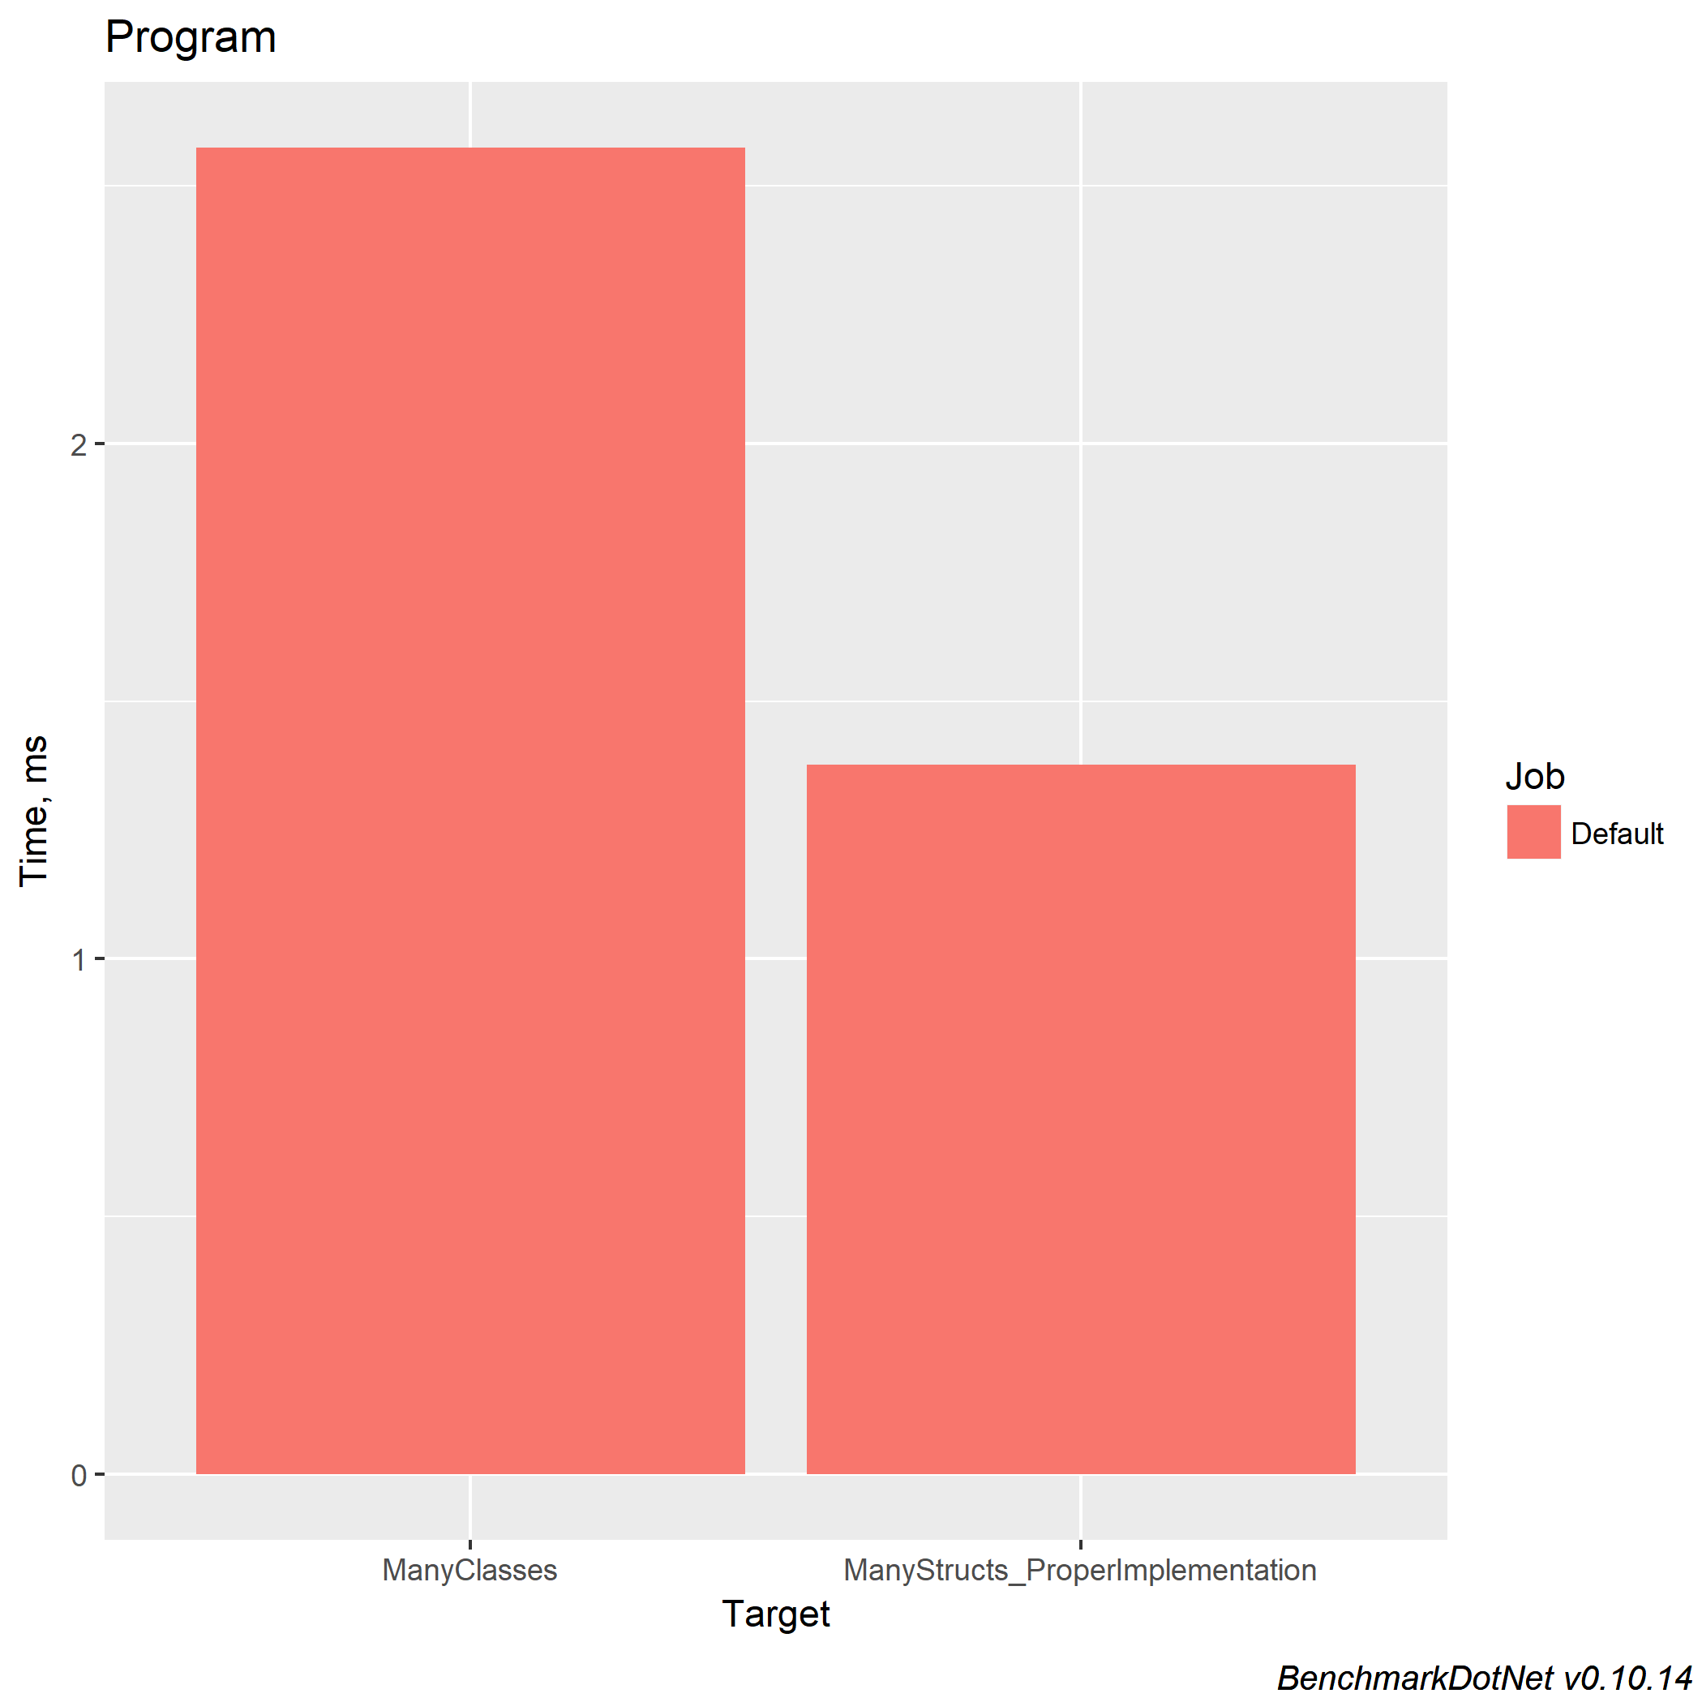
Benchmark: class vs. struct
https://github.com/gregkalapos/DWX2018_SampleCode/tree/master/RefAndSpan/StructVsClass

Slide 35
Value Types - Nachteile
No OOP, no lock(valuetype){}
Value Semantic: By default value types are copied (the value inside it is copied)
public struct Matrix_Struct
{
public int i00, i01, i02;
public int i10, i11, i12;
public int i20, i21, i22;
}
public static void DoSomethingWithMatrix(Matrix_Struct matrix_Struct)
{
//...
}

Slide 36
Value Types - Benchmark
public class Matrix_Class
{
public int i00, i01, i02;
public int i10, i11, i12;
public int i20, i21, i22;
}
public struct Matrix_Struct
{
public int i00, i01, i02;
public int i10, i11, i12;
public int i20, i21, i22;
}
[Benchmark]
public static void BenchmarkMatrixClass()
{
PrintFirstItem(MatrixClass);
}
public static void PrintFirstItem(Matrix_Class matrix_Class)
=> Debug.WriteLine(matrix_Class.i00);
[Benchmark]
public static void BenchmarkMatrixStruct()
{
PrintFirstItem(MatrixStruct);
}
public static void PrintFirstItem(Matrix_Struct matrix_Struct)
=> Debug.WriteLine(matrix_Struct.i00);

Slide 37
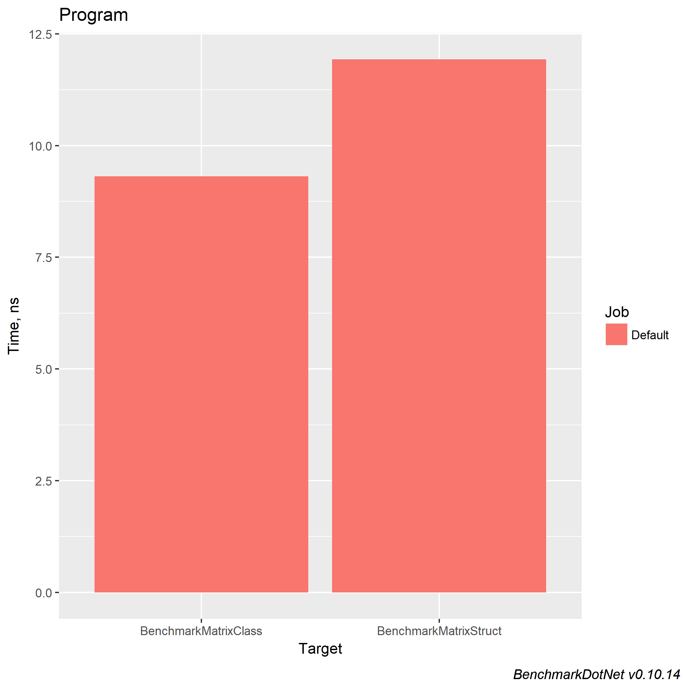
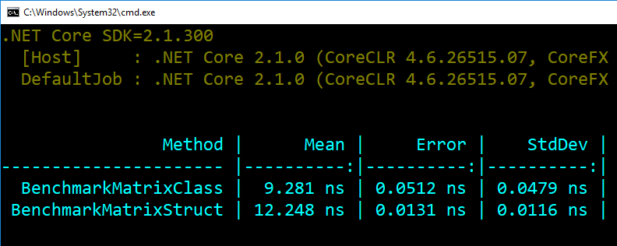
Value Types - Benchmark
Class vs. Struct als Method Parameter
https://github.com/gregkalapos/ADC19Samples/tree/master/RefAndSpan/StructVsClass_MethodParameter

Slide 38
Value Types
Solution: pass by reference
public struct Matrix_Struct
{
public int i00, i01, i02;
public int i10, i11, i12;
public int i20, i21, i22;
}
public static void DoSomethingWithMatrix(ref Matrix_Struct matrix_Struct)
{
//...
}

Slide 39
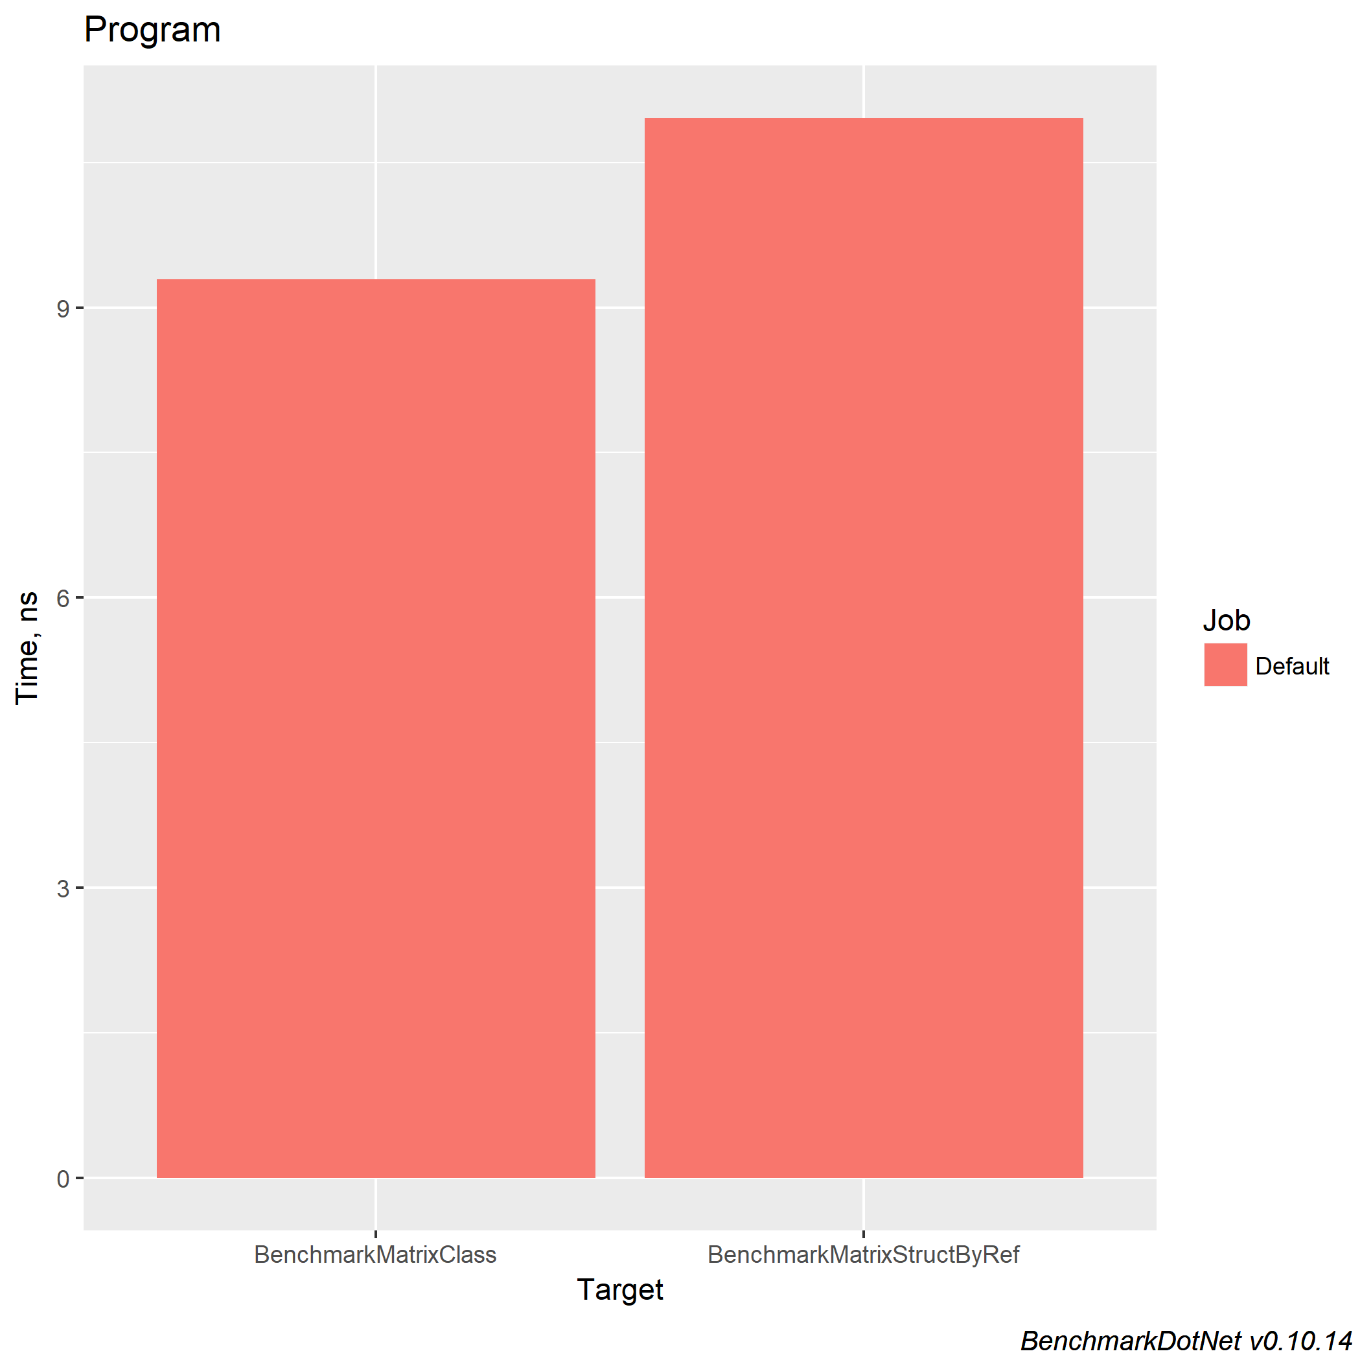
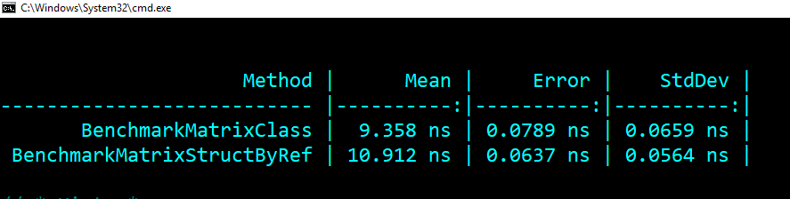
Value Types
Solution: pass by reference
https://github.com/gregkalapos/ADC19Samples/tree/master/RefAndSpan/StructVsClass_MethodParameter_PassByReference

Slide 40
Ref keyword in C# = Managed pointer in the CLR
C#:
public static void PrintFirstItem_Struct(Matrix_Struct matrix_Struct)
IL:
.method public hidebysig static void PrintFirstItem_Struct ( valuetype SampleProject.Matrix_Struct matrix_Struct ) cil managed
C#:
public static void PrintFirstItem_Struct_Ref(ref Matrix_Struct matrix_Struct)
IL:
.method public hidebysig static void PrintFirstItem_Struct_Ref ( valuetype SampleProject.Matrix_Struct& matrix_Struct ) cil managed

Slide 41
Ref return
Since C# 7 we can also use the “ref” keyword with the type
public static ref Matrix DoSomethingWithMatrix(ref Matrix matrix)
{
//...
return ref matrix;
}
.method public hidebysig static valuetype SampleApp.Matrix& DoSomethingWithMatrix ( valuetype SampleApp.Matrix& matrix ) cil managed

Slide 42
Ref return – Sample 1
public static ref Matrix GetBiggerByReference(ref Matrix matrix1, ref Matrix matrix2)
{
var sum1 = matrix1.i00 + matrix1.i01 + matrix1.i02 +
matrix1.i10 + matrix1.i11 + matrix1.i12 +
matrix1.i20 + matrix1.i21 + matrix1.i22;
var sum2 = matrix2.i00 + matrix2.i01 + matrix2.i02 +
matrix2.i10 + matrix2.i11 + matrix2.i12 +
matrix2.i20 + matrix2.i21 + matrix2.i22;
if (sum2 > sum1)
return ref matrix2;
else
return ref matrix1;
}

Slide 43
Ref return – Benchmark
public static ref Matrix GetBiggerByReference(ref Matrix matrix1, ref Matrix matrix2)
Vs.
public static Matrix GetBiggerByValue(Matrix matrix1, Matrix matrix2)
[Benchmark]
public static void RefReturnPerf()
{
for (int i = 0; i < 1000; i++)
{
var item1 = matrixList[i].Item1;
var item2 = matrixList[i].Item2;
ref Matrix biggerMatrix = ref GetBiggerByReference(ref item1, ref item2);
Debug.WriteLine(biggerMatrix.i00);
}
}

Slide 44
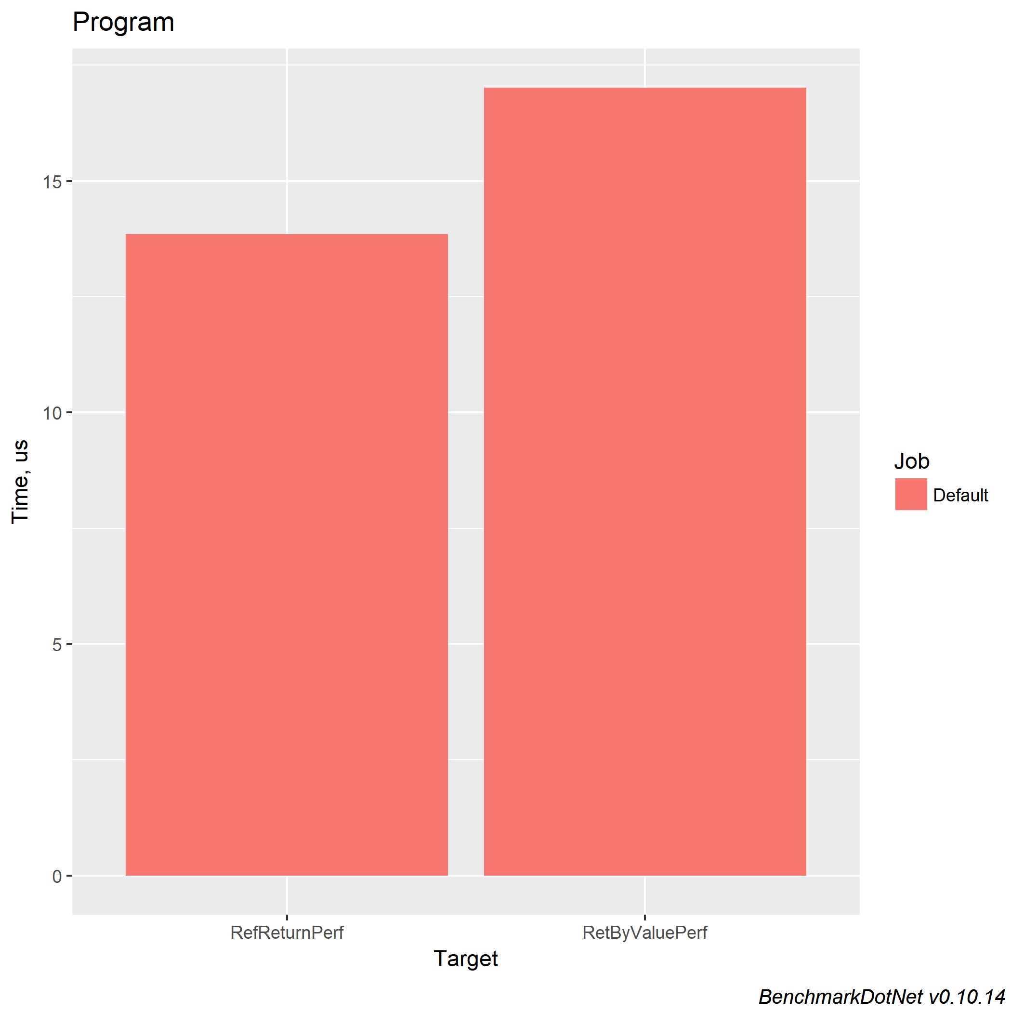
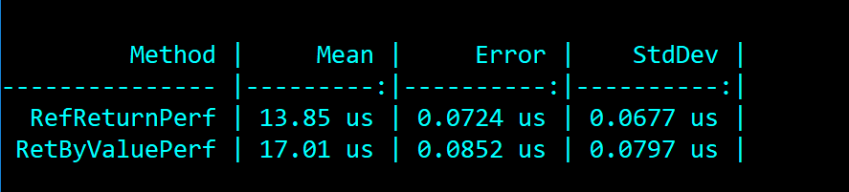
Ref return - Benchmark
https://github.com/gregkalapos/ADC19Samples/tree/master/RefAndSpan/RefReturnMatrix

Slide 45
Ref return – Sample 2
class MyList
{
private int[] _items = { 3, 4, 7, 1, 4, 6 };
}
public ref int GetRefToSmallestItem()
{
var smallest = _items[0];
int index = 0;
for (int i = 1; i < _items.Length; i++)
{
if (_items[i] < smallest)
{
smallest = _items[i];
index = i;
}
}
return ref _items[index];
}

Slide 46
Ref return – Sample 2
static void Main(string[] args)
{
MyList l = new MyList();
ref int i = ref l.GetRefToSmallestItem();
i = 42;
}
.method private hidebysig static void Main ( string[] args ) cil managed { .maxstack 2 .entrypoint .locals init ( [0] class CollectionWithRef.MyList, [1] int32& )
/* 0x000002E6 0A */ IL_0006: stloc.0 /* 0x000002E7 06 */ IL_0007: ldloc.0 /* 0x000002E8 6F01000006 */ IL_0008: callvirt instance int32& CollectionWithRef.MyList::GetRefToSmallestItem() /* 0x000002ED 0B */ IL_000D: stloc.1 /* 0x000002EE 07 */ IL_000E: ldloc.1 /* 0x000002EF 1F2A */ IL_000F: ldc.i4.s 42

Slide 47
Ref in C# 7 – what can we return with “ref"?
Ref Parameter
public ref int MethodReturningIntByRef(ref int myInt)
{
//...do something with ‘myInt’
return ref myInt;
}
Out Parameter
public ref int MethodReturningIntByRef(out int myInt)
{
myInt = 42;
//...do something with 'myInt’
return ref myInt;
}

Slide 48
Ref in C# 7 – what can we return with “ref"?
In Parameter (C# 7.2)
public ref readonly int MethodReturningIntByRef(in int myInt)
{
//...do something with 'myInt’
return ref myInt;
}
Instance variables of a type
class MyClass
{
private int myInt;
public ref int GetRefToMyInt() => ref myInt;
}

Slide 49
Ref in C# 7 – what CAN’T we return with “ref"
Lokale variables
public ref int MyMethod()
{
int i = 42;
return ref i;
}
‚null‘
‚this‘
public ref object MyMethod()
{
return ref null;
}
public ref object MyMethod()
{
return ref this;
}

Slide 50
Ref in C# 7 – what CAN’T we return with “ref"
async methods
public async ref Task<int> MyMethod()
{
//let's do something async:
await Task.Delay(500);
return ref 42;
}
consts
‚enum‘
const int I = 42;
public ref int MyMethod()
{
return ref I;
}
public enum Day { Monday, Friday }
public ref Day MyMethod()
{
var day = Day.Monday;
return ref day;
}

Slide 51
Ref return – Where is it used?
ASP.NET Core
Span<T>

Slide 52
Span<T>

Slide 53
Allocation in .NET
Managed memory
byte[] myArray = new byte[100];
Unmanaged memory
IntPtr myArray = Marshal.AllocHGlobal(100);
//...use myArray
Marshal.FreeHGlobal(myArray);
Stack memory
byte* myArray = stackalloc byte[100];

Slide 54
Accepting handles to different types of memory in an API
„High Performance“ libraries usually use managed and unmanaged (e.g. stack) memory as well (E.g.: ASP.NET Core/Kestrel)
But it’s very hard to deal with this
public void ProcessByteArray(byte[] array)
public void ProcessByteArray(void* array)
public void ProcessByteArray(byte[] array, int offset)
public void ProcessByteArray(void* array, int offset)

Slide 55
Span<T>
Represents a contiguous region of memory
An abstraction over every type of memory that we can allocate in .NET
.NET Standard 1.0
public void ProcessByteArray(Span<byte> array)

Slide 56
Span<T> - wrapping memory from the managed heap
byte[] myArray = new byte[100];
Span<byte> myArraySpan = new Span<byte>(myArray);
ProcessByteArray(myArraySpan);

Slide 57
Span<T> - wrapping unmanaged memory
IntPtr myArray = Marshal.AllocHGlobal(100);
Span<byte> nativeSpan;
unsafe
{
nativeSpan = new Span<byte>(myArray.ToPointer(), 100);
}
ProcessByteArray(nativeSpan);
Marshal.FreeHGlobal(myArray);

Slide 58
Span<T> - wrapping stack memory
Since C# 7.2:
Span<byte> stackSpan;
unsafe
{
byte* myArray = stackalloc byte[100];
stackSpan = new Span<byte>(myArray, 100);
}
ProcessByteArray(stackSpan);
Span<byte> stackSpan = stackalloc byte[100];
ProcessByteArray(stackSpan);

Slide 59
Span<T>
Span<T>
Start
Arbitrary memory (can be managed, unmanaged, stack allocated)
Offset
Size

Slide 60
Span<T> API
Span erstellen:
public Span(T[] array);
public Span(void* pointer, int length);
public Span(T[] array, int start, int length)
Indexing:
public ref T this[int index] { get; }
Slicing:
public Span<T> Slice(int start);
public Span<T> Slice(int start, int length);
(*Not a complete list of all methods!)

Slide 61
Span<T>.Slice(start, length)
byte[] array = new byte[] { 1, 2, 3, 4 };
Span<byte> span = new Span<byte>(array);
1
2
3
4
Span<byte> newSpan = span.Slice(1, 3);
This does not allocate at all

Slide 62
Span<T> - Performance Advantage
FullString: Span<char>
Start
Offset
Size: 10
‘a’
‘b’
‘c’
‘d’
‘e’
‘f’
‘g
‘h’
‘i’
‘j’
SecondHalf: Span<char>
Start
FirstHalf: Span<char>
Offset
Start
Size: 5
Offset
Size: 5

Slide 63
Span use cases
String parsing
Encoding
Formatting
Compression/Decompression
Data Pipelines
JSON Serialization/Deserialization (System.Text.Json-in .NET Core 3.0)
HTTP server:
Socket fills buffer
HTTP Parsing
Decompression
Base 64 decoding
Routing
HTML Writing
HTTP writing
HTTP writing

Slide 64
Span<T> - String parsing
public static void WorkWithSpan()
{
ReadOnlySpan<char> str = @"Request URL: http://kalapos.net/
Request Method:GET
Status Code:200 OK
Remote Address:81.10.250.159:80
Referrer Policy:no-referrer-when-downgrade
Accept:texvt/html,application/xhtml+xml,application/xml;q=0.9,
Accept-Encoding:gzip, deflate
Accept-Language:de-DE,de;q=0.8,en-US;q=0.6,en;q=0.4,hu;q=0.2
Connection:keep-alive
Cookie:__cfduid=d37ec605870fbb75a1b5b9616bf161ed01507890791; _ga=GA1.2.460922426.1476689834; _gid=GA1.2.1163677089.1508317942
Host:kalapos.net
Upgrade-Insecure-Requests:1
User-Agent:Mozilla/5.0 (Windows NT 10.0; Win64; x64) AppleWebKit/537.36 (KHTML, like Gecko) Chrome/61.0.3163.100 Safari/537.36".AsSpan();
ParseStringSpan(str);
}

Slide 65
Span<T> - String parsing
public static void ParseStringSpan(ReadOnlySpan<char> str)
{
var url = str.Slice(13, 19);
var method = str.Slice(58, 3);
Int32.TryParse(str.Slice(84, 3), out int statusCode);
var remoteAddr = str.Slice(116, 14);
var referrerPolicy = str.Slice(157, 26);
var accept = str.Slice(201, 85);
var acceptEncoding = str.Slice(313, 13);
var acceptLanguage = str.Slice(353, 44);
var connection = str.Slice(419, 10);
var cookie = str.Slice(447, 118);
var host = str.Slice(581, 11);
Int32.TryParse(str.Slice(629, 1), out int updgradeInsecureRequest);
var userAgent = str.Slice(652, 115);
}
public static void ParseStringClassic(String str)
{
var url = str.Substring(13, 19);
var method = str.Substring(58, 3);
Int32.TryParse(str.Substring(84, 3), out int statusCode);
var remoteAddr = str.Substring(116, 14);
var referrerPolicy = str.Substring(157, 26);
var accept = str.Substring(201, 85);
var acceptEncoding = str.Substring(313, 13);
var acceptLanguage = str.Substring(353, 44);
var connection = str.Substring(419, 10);
var cookie = str.Substring(447, 118);
var host = str.Substring(581, 11);
Int32.TryParse(str.Substring(629, 1), out int updgradeInsecureRequest);
var userAgent = str.Substring(652, 115);
}

Slide 66
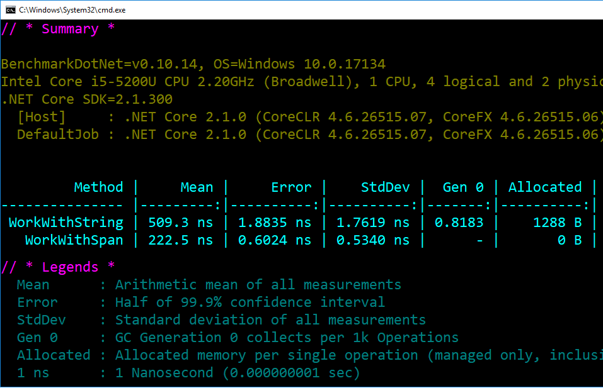
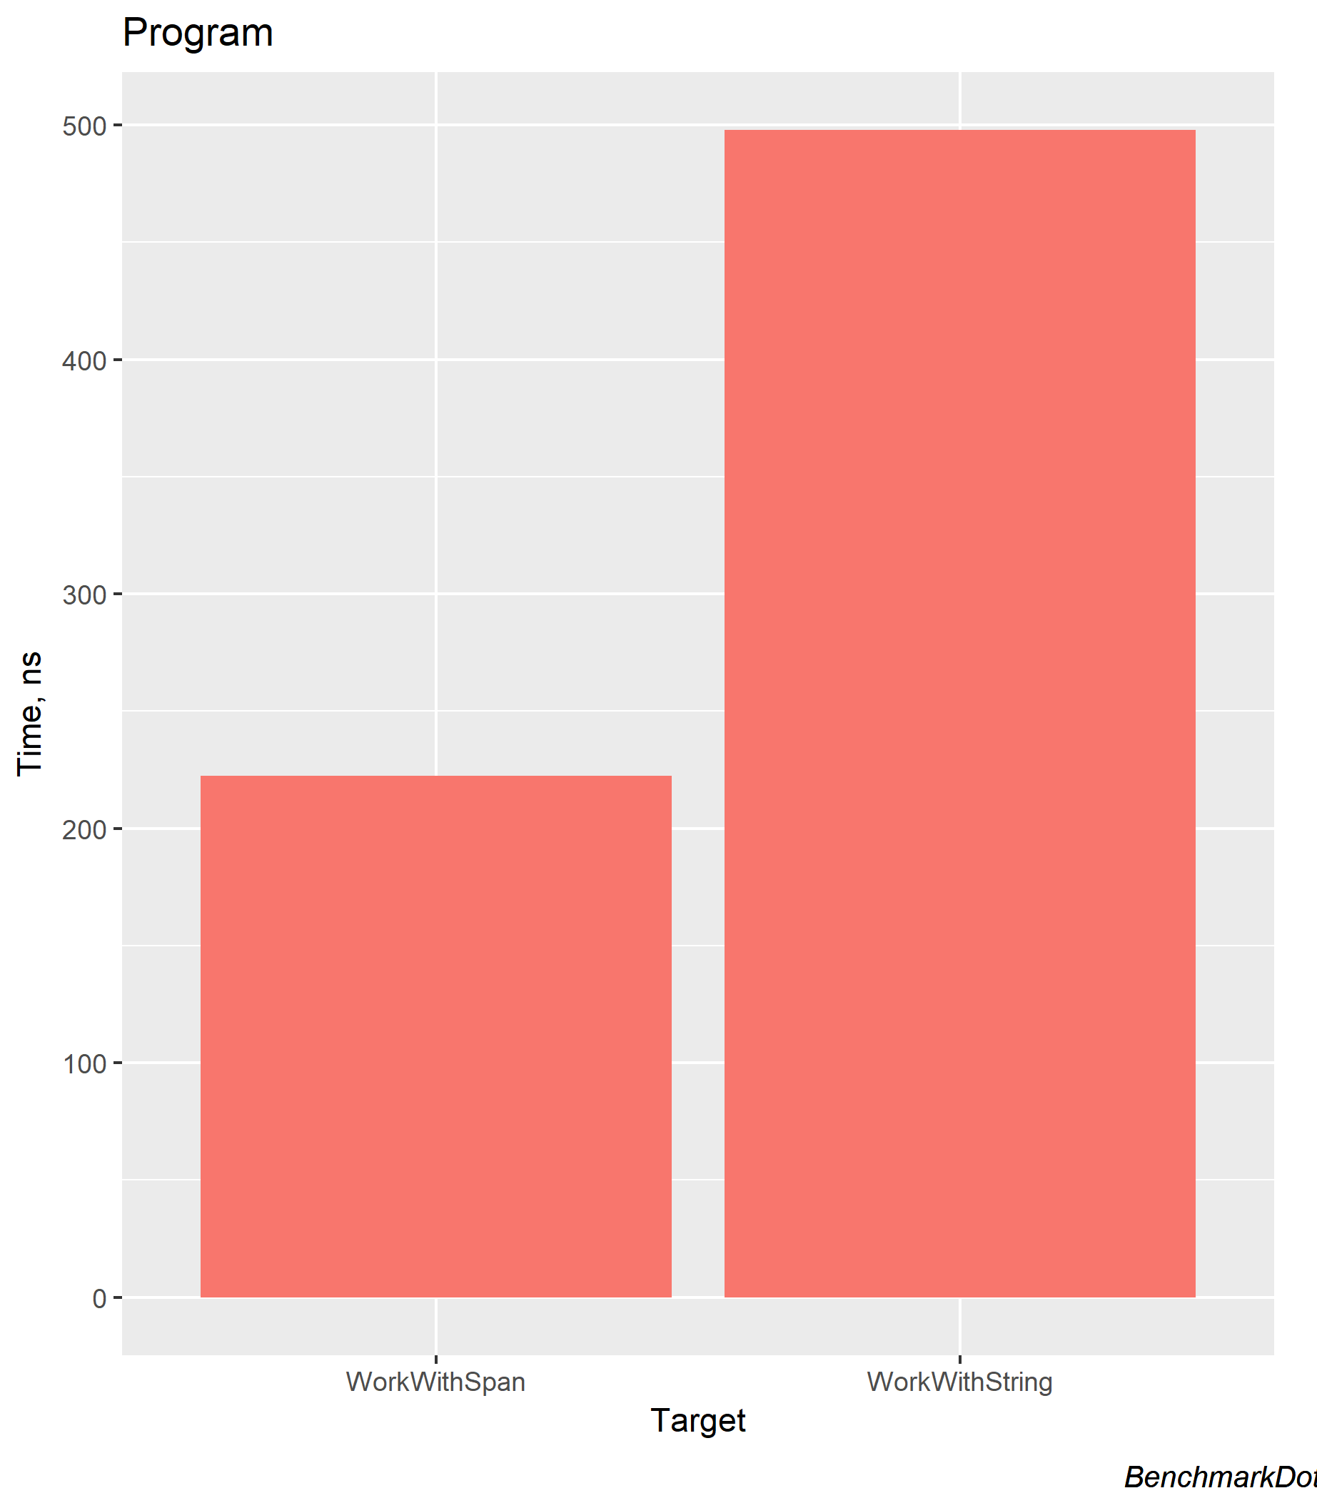
Span<T> - Benchmark
https://github.com/gregkalapos/ADC19Samples/tree/master/RefAndSpan/StringParsingWithSpan

Slide 67
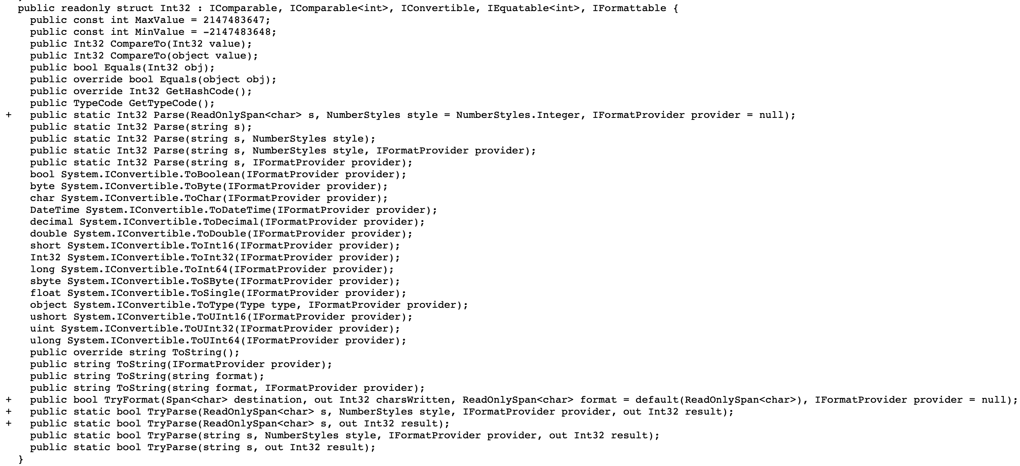
.NET Standard 2.1
~3K new API
Lots of them are Span<T> or ReadonlySpan<T> overloads

Slide 68
SIMD
Part of .NET Standard 2.1
Single instruction, multiple data
Parallelism
Perform the same operation on multiple data points simultaneously

Slide 69
SIMD - Classic Assembly (no SIMD)
C# Code
add (adds 2 integers, result: 1 integer) add eax, ebx
mov: mov ebx, count
Take 1 or 2 values and produces single result
Compile time
C# Compiler
IL Code
JIT Compiler
Run time
Machine Code

Slide 70
SIMD - Classic Assembly (no SIMD)
2,
1,
7,
5,
6,
7,
8,
4
2,
2,
1,
3,
2,
1,
1,
2
Add 2,2
4
Add 1,2
3
Add 7,1 1,2
8
Add 5,3 1,2
8
+
8
Add 6,2 1,2
Add 7,1 1,2
8
Add 8,1 1,2
9
Add 4,2
6
Time (CPU cycles)

Slide 71
SIMD
Single instruction, multiple data
Those instructions can have multiple operands
vpaddd: add packed doubleword integers

Slide 72
SIMD in .NET
If the CPU supports SIMD, the JIT compiler emits SIMD instructions
System.Numerics namespace

Slide 73
SIMD - add 2 arrays with `vpaddd`
vpaddd
Operates on 8 integers at the same time!
2,
1,
7,
5,
6,
7,
8,
4
2,
2,
1,
3,
2,
1,
1,
2
2,
1,
7,
5,
6,
7,
8,
4
2,
2,
1,
3,
2,
1,
1,
2
4,
3,
8,
8,
8,
8,
9,
6
+
Time (CPU cycles)

Slide 74
Add 2 array, no SIMD
public static double[] AddArrays_Simple(double[] v1, double[] v2)
{
double[] retVal = new double[v1.Length];
for (int i = 0; i < v1.Length; i++)
{
retVal[i] = v1[i] + v2[i];
}
return retVal;
}

Slide 75
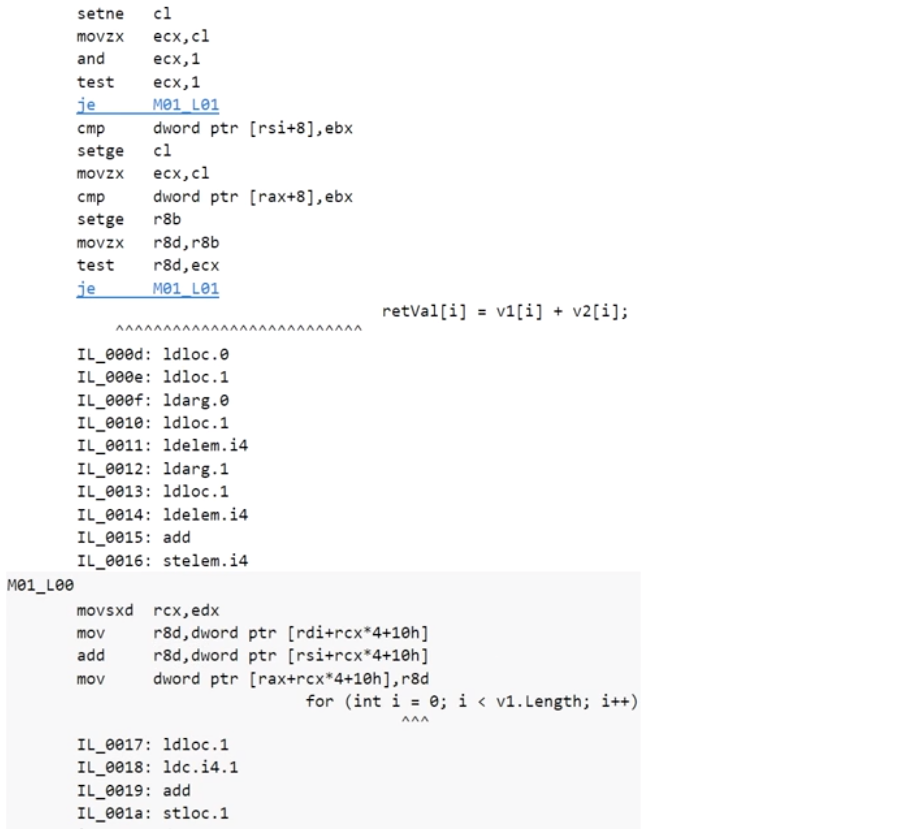
Add 2 array, no SIMD

Slide 76
Add 2 array, with SIMD
public static double[] AddArrays_Vector(double[] v1, double[] v2)
{
double[] retVal = new double[v1.Length];
var vectSize = Vector<double>.Count;
int i = 0;
for (i = 0; i <= v1.Length - vectSize; i += vectSize)
{
var va = new Vector<double>(v1, i);
var vb = new Vector<double>(v2, i);
var vc = va + vb;
vc.CopyTo(retVal, i);
}
if (i != v1.Length)
{
for (int j = i; j < v1.Length; j++)
{
retVal[j] = v1[j] + v2[j];
}
}
return retVal;
}

Slide 77
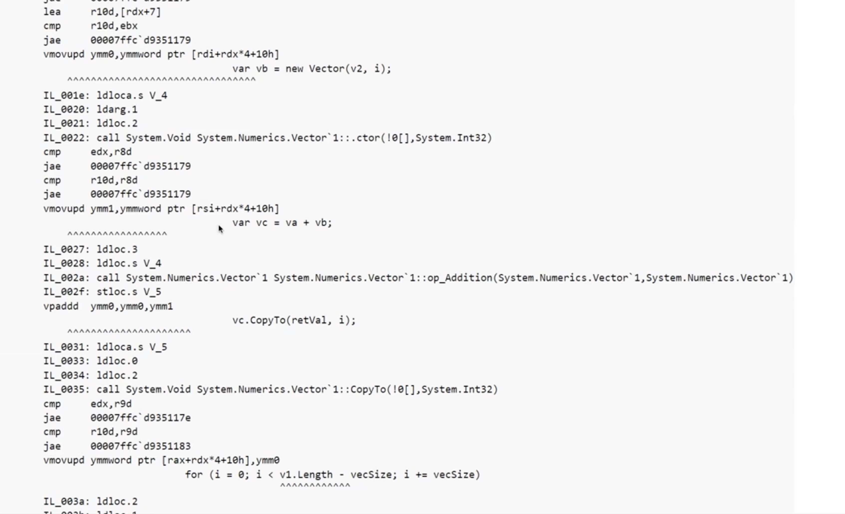
Add 2 array, with SIMD

Slide 78
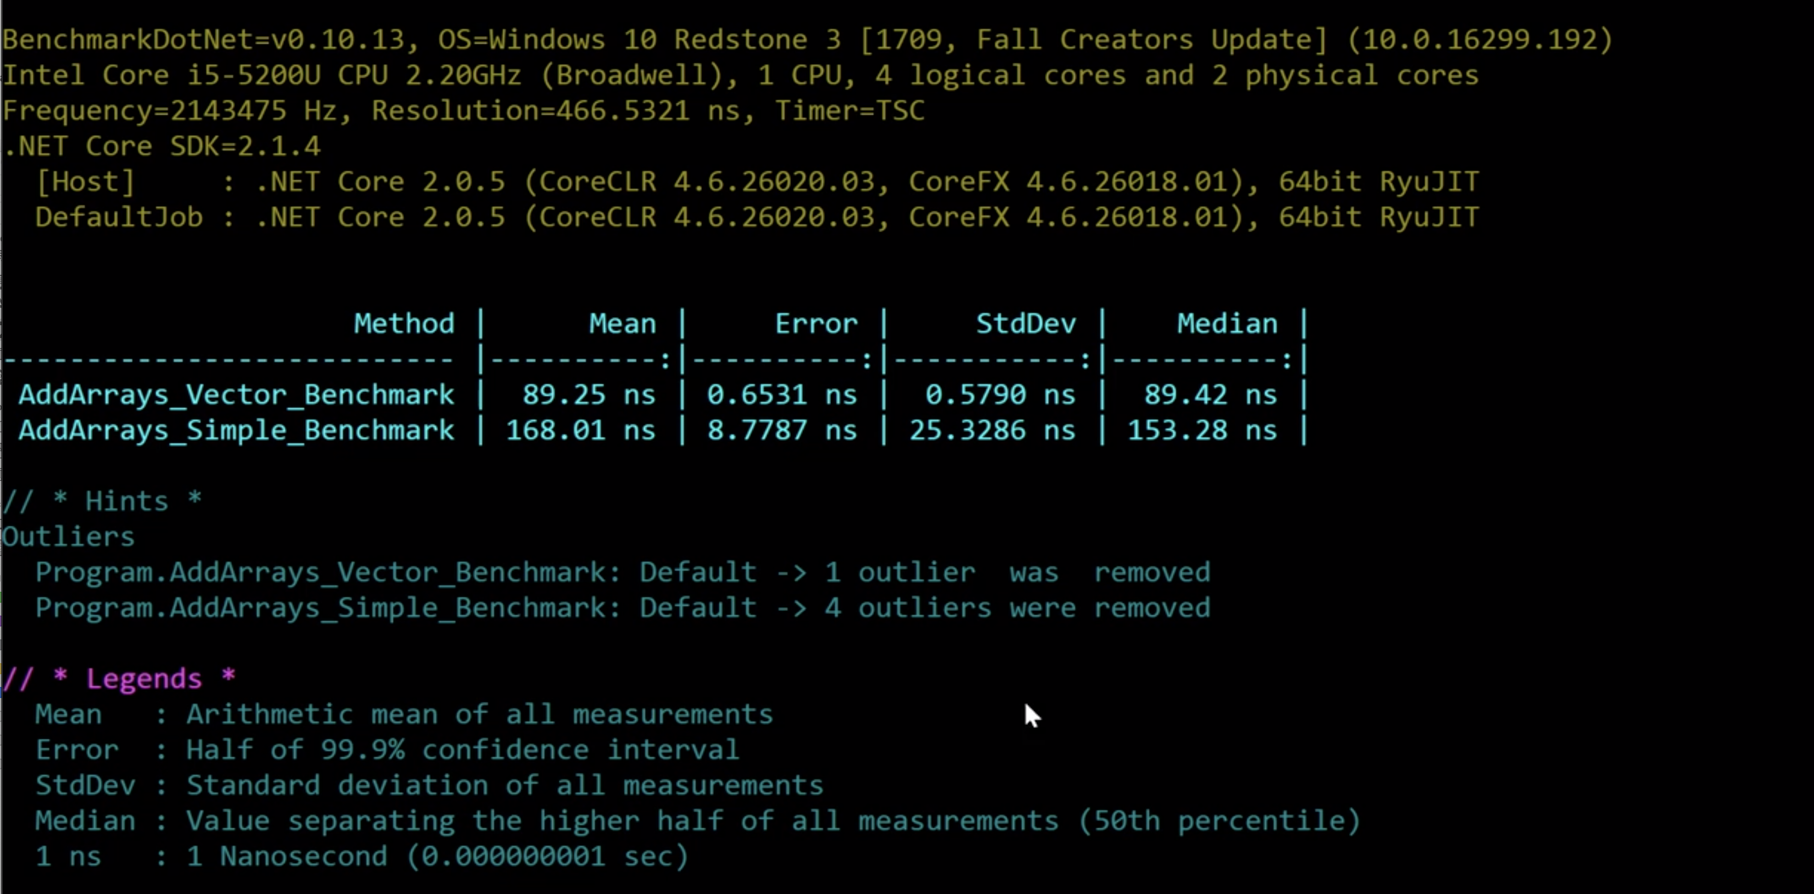
SIMD vs. Simple loop

Slide 79
Resources
State of the .NET Performance - Adam Sitnik (http://adamsitnik.com) https://www.youtube.com/watch?v=CSPSvBeqJ9c
Vladimir Sadov - http://mustoverride.com
BenchmarkDotNet: https://benchmarkdotnet.org/
Ref return and ref locals (Microsoft): https://docs.microsoft.com/en-us/dotnet/csharp/programming-guide/classes-and-structs/ref-returns

Slide 80
Sample code + Slides
Slides and Sample code: https://github.com/gregkalapos/ADC19Samples
Twitter: @gregkalapos (https://twitter.com/gregkalapos)

